Slide 1

Revenue Concepts

Slide 2
Total Revenue, Average Revenue and Marginal Revenue
Revenue maximization (Objective of the seller/Firm).
Each seller has sufficient market power to set the selling price higher and sell less or set the selling price lower and sell more.
The demand curve facing the consumer is downward sloping.

Slide 3
Total Revenue
Total revenue ( TR ) is the total amount of money(or some other good) that a firm receives from the sale of its goods.
TR = P x Q

Slide 4
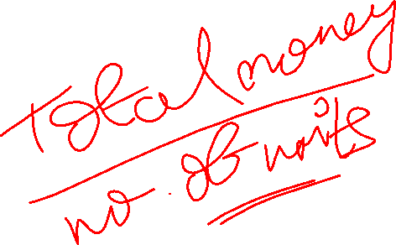
Average Revenue
Average revenue ( AR ) is the total amount of money(or some other good) that a firm receives from the sale divided by the number of units of goods sold.
AR = TR/Q, since TR=P x Q, then AR = P.

Slide 5
Marginal Revenue
Marginal revenue ( MR ) is the change in total revenue resulting from selling an extra unit of goods.
MR = ΔTR/ΔQ, where ΔTR = change in TR due to change in Q, ΔQ = change in Q

Slide 6
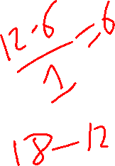
Total, Average and Marginal Revenue under Single Price
Quantity (Q) | Price ($) (Single Price) | Total Revenue (TR=P*Q) | Average Revenue (AR=TR/Q) | Marginal Revenue (MR = ΔTR/ΔQ )
0 | $6 | 0 | - | -
1 | 6 | $6 | $6 | 6
2 | 6 | 12 | 6 | 6
3 | 6 | 18 | 6 | 6
4 | 6 | 24 | 6 | 6
5 | 6 | 30 | 6 | 6
6 | 6 | 36 | 6 | 6
7 | 6 | 42 | 6 | 6
8 | 6 | 48 | 6 | 6

Slide 7
Total, Average and Marginal Revenue under Multiple Prices
Quantity (Q) | Price (P) (Multiple prices) | Total Revenue (TR=P*Q) | Average Revenue (AR=TR/Q) | Marginal Revenue (MR = ΔTR/ΔQ )
0 | $11 | 0 | - | -
1 | 10 | 10 | 10 | 10
2 | 9 | 18 | 9 | 8
3 | 8 | 24 | 8 | 6
4 | 7 | 28 | 7 | 4
5 | 6 | 30 | 6 | 2
6 | 5 | 30 | 5 | 0
7 | 4 | 28 | 4 | -2
8 | 3 | 24 | 3 | -4
9 | 2 | 18 | 2 | -6
10 | 1 | 10 | 1 | -8

Slide 8

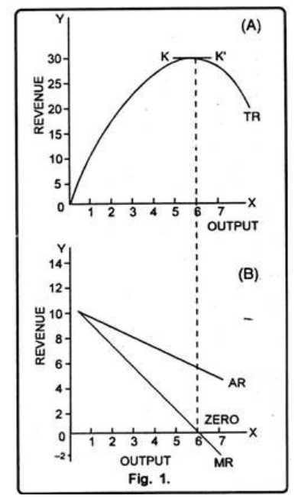
Graphical Illustration

Slide 9
Numerical Examples

Slide 10
Suppose Q=20-2P. Where Q is output and P is price. Find the Marginal Revenue (MR) function.
Total revenue from the sale of the good X is given by the equation for
(where R is total revenue and Q is quantity bought at price P). Calculate MR and AR functions.

Slide 11

3. Consider the following demand functions:
P=4
P=100-4Q
Calculate total, average and marginal revenue functions for each one. At what point, total revenue is maximized in each case?
Note:Total Revenue is Maximized when Marginal Revenue = Zero.

Slide 12


Revenue and Elasticity
Relationship between MR and Price Elasticity.
Where MR – Marginal Revenue
e – Price Elasticity (or, Ep)

Slide 13
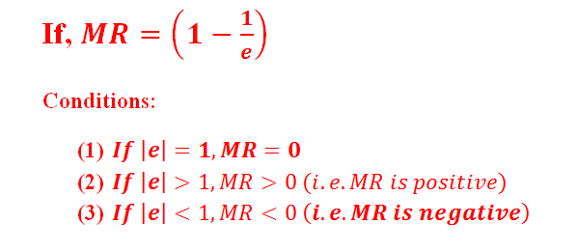
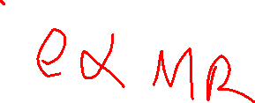

Slide 14
Thank you.

